Slide 1
COMP 2400
Week 1 - Friday

Slide 2
Last time
What did we talk about last time?
More C basics
C compilation model
History of Unix and Linux

Slide 3
Questions?

Slide 4
Project 1

Slide 5
Quotes
ANSI C retains the basic philosophy that programmers know what they are doing; it only requires that they state their intentions explicitly.
  Kernighan and Ritchie
  from The C Programming Language, 2nd Edition

Slide 6
C Literals

Slide 7
Literals
By default, every integer is assumed to be a signed int
If you want to mark a literal as long, put an L or an l at the end
  long value = 2L;
  Don't use l, it looks too much like 1
  There's no way to mark a literal as a short
If you want to mark it unsigned, you can use a U or a u
  unsigned int x = 500u;
Every value with a decimal point is assumed to be double
If you want to mark it as a float, put an f or an F at the end
  float z = 1.0f;

Slide 8
Integers in other bases
You can also write a literal in hexadecimal or octal
A hexadecimal literal begins with 0x
  int a = 0xDEADBEEF;
  Hexadecimal digits are 0 – 9 and A – F (upper or lower case)
An octal literal begins with 0
  int b = 0765;
  Octal digits are 0 – 7
  Be careful not to prepend other numbers with 0, because they will be in octal!
Remember, this changes only how you write the literal, not how it's stored in the computer
Can't write binary literals

Slide 9
Printing in other bases
The printf() function provides flags for printing out integers in:
  %d Decimal
  %x Hexadecimal (%X will print A-F in uppercase)
  %o Octal
printf("%d", 1050); // Prints 1050
printf("%x", 1050); // Prints 41a
printf("%X", 1050); // Prints 41A
printf("%o", 1050); // Prints 2032

Slide 10
Data Representation

Slide 11
Base 10 (decimal) numbers
Our normal number system is base 10
This means that our digits are: 0, 1, 2, 3, 4, 5, 6, 7, 8, and 9
Base 10 means that you need 2 digits to represent ten, namely 1 and 0
Each place in the number as you move left corresponds to an increase by a factor of 10

Slide 12
Base 10 Example
Ten thousands
Hundreds
3,482,931
Millions
Ones
Hundred
thousands
Tens
Thousands

Slide 13
Base 2 (binary) numbers
The binary number system is base 2
This means that its digits are: 0 and 1
Base 2 means that you need 2 digits to represent two, namely 1 and 0
Each place in the number as you move left corresponds to an increase by a factor of 2 instead of 10

Slide 14
Base 2 Example
Sixty fours
256's
Sixteens
Fours
11111101000
1024's
Ones
512's
Twos
128's
Eights
Thirty twos

Slide 15
Binary representation
This system works fine for unsigned integer values
  However many bits you've got, take the pattern of 1's and 0's and convert to decimal
What about signed integers that are negative?
  Most modern hardware (and consequently C and Java) use two's complement representation

Slide 16
Two's complement
Two's complement only makes sense for a representation with a fixed number of bits
  But we can use it for any fixed number
If the most significant bit (MSB) is a 1, the number is negative
  Otherwise, it's positive
Unfortunately, it's not as simple as flipping the MSB to change signs

Slide 17
Negative integer in two's complement
Let's say you have a positive number n and want the representation of –n in two's complement with k bits
Figure out the pattern of k 0's and 1's for n
Flip every single bit in that pattern (changing all 0's to 1's and all 1's to 0's)
  This is called one's complement
Then, add 1 to the final representation as if it were positive, carrying the value if needed

Slide 18
Example
For simplicity, let's use 4-bit, two's complement
Find -6
6 is 0110
Flipped is 1001
Adding 1 gives 1010

Slide 19
Two's complement to negative integer
Let's say you have a k bits representation of a negative number and want to know what it is
Subtract 1 from the representation, borrowing if needed
Flip every single bit in that pattern (changing all 0's to 1's and all 1's to 0's)
Determine the final integer value

Slide 20
Example
For simplicity, let's use 4-bit, two's complement
Given 1110
Subtracting 1 1101
Flipped is 0010
Which is 2, meaning that the value is -2

Slide 21
All four bit numbers
Binary | Decimal | Binary | Decimal
0000 | 0 | 1000 | -8
0001 | 1 | 1001 | -7
0010 | 2 | 1010 | -6
0011 | 3 | 1011 | -5
0100 | 4 | 1100 | -4
0101 | 5 | 1101 | -3
0110 | 6 | 1110 | -2
0111 | 7 | 1111 | -1

Slide 22
But why?!
Using the flipping system makes it so that adding negative and positive numbers can be done without any conversion
  Example 5 + -3 = 0101 + 1101 = 0010 = 2
  Overflow doesn't matter
Two's complement (adding the 1 to the representation) is needed for this to work
  It preserves parity for negative numbers
  It keeps us with a single representation for zero
  We end up with one extra negative number than positive number

Slide 23
Floating point representation
Okay, how do we represent floating point numbers?
A completely different system!
  IEEE-754 standard
  One bit is the sign bit
  Then some bits are for the exponent (8 bits for float, 11 bits for double)
  Then some bits are for the mantissa (23 bits for float, 52 bits for double)

Slide 24
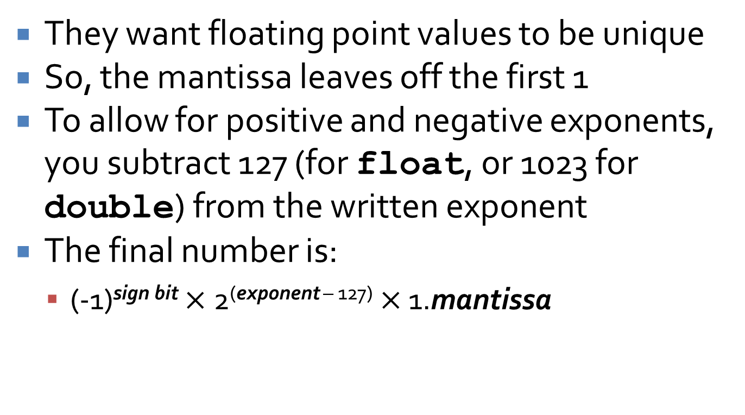
More complexity
They want floating point values to be unique
So, the mantissa leaves off the first 1
To allow for positive and negative exponents, you subtract 127 (for float, or 1023 for double) from the written exponent
The final number is:
  (-1)^{sign bit} $×$ 2^{(exponent – 127)} $×$ 1.mantissa

Slide 25
Except even that isn't enough!
How would you represent zero?
  If all the bits are zero, the number is 0.0
There are other special cases
  If every bit of the exponent is set (but all of the mantissa is zeroes), the value is positive or negative infinity
  If every bit of the exponent is set (and some of the mantissa bits are set), the value is positive or negative NaN (not a number)
Number | Representation
0.0 | 0x00000000
1.0 | 0x3F800000
0.5 | 0x3F000000
3.0 | 0x40400000
+Infinity | 0x7F800000
-Infinity | 0xFF800000
+NaN | 0x7FC00000 and others

Slide 26
One little endian
For both integers and floating-point values, the most significant bit determines the sign
  But is that bit on the rightmost side or the leftmost side?
  What does left or right even mean inside a computer?
The property is the endianness of a computer
Some computers store the most significant bit first in the representation of a number
  These are called big-endian machines
Others store the least significant bit first
  These are called little-endian machines

Slide 27
Why does it matter?
Usually, it doesn't!
It's all internally consistent
  C uses the appropriate endianness of the machine
With pointers, you can look at each byte inside of an int (or other type) in order
  When doing that, endianness affects the byte ordering
The term is also applied to things outside of memory addresses
Mixed-endian is rare for memory, but possible in other cases:
http://faculty.otterbein.edu/ | wittman1/comp2400/
More specific
More specific

Slide 28
Math Library

Slide 29
Math library
Function | Result | Function | Result
cos(double theta) | Cosine of theta | exp(double x) | e^{x}
sin(double theta) | Sine of theta | log(double x) | Natural logarithm of x
tan(double theta) | Tangent of theta | log10(double x) | Common logarithm of x
acos(double x) | Arc cosine of x | pow(double base, double exponent) | Raise base to power exponent
asin(double x) | Arc sine of x | sqrt(double x) | Square root of x
atan(double x) | Arc tangent of x | ceil(double x) | Round up value of x
atan2(double y, double x) | Arc tangent of y/x | floor(double x) | Round down value of x
fabs(double x) | Absolute value of x | fmod(double value, double divisor) | Remainder of dividing value by divisor

Slide 30
Math library in action
You must #include <math.h> to use math functions
#include <math.h>
#include <stdio.h>
int main()
{
double a = 3.0;
double b = 4.0;
double c = sqrt(a*a + b*b);
  printf("Hypotenuse: %f\n", c);
  return 0;
}

Slide 31
It doesn't work!
Just using #include gives the headers for math functions, not the actual code
You must link the math library with flag –lm
Now, how are you supposed to know that?
> gcc hypotenuse.c -o hypotenuse -lm
> man 3 sqrt

Slide 32
My main man
Man (manual) pages give you more information about commands and functions, in 8 areas:
  General commands
  System calls
  Library functions (C library, especially)
  Special files and devices
  File formats
  Miscellaneous stuff
  System administration
Try by typing man topic for something you're interested in
If it lists topics in different sections, specify the section
For more information:
> man 3 sqrt
> man man

Slide 33
Upcoming

Slide 34
Next time…
Preprocessor directives
Single character I/O

Slide 35
Reminders
Keep reading K&R Chapter 1
Keep working on Project 1
No class Monday!

